Slide 1

Problem Statement and Team Details
Problem Statement: Stock Market Consultant Agent
Team Name: Technicians
Team Leader Name: Babbula Nishanth
Institute Name: KLH University
Team Leader Email ID:

Slide 2
Problem and Solution
Many beginners who start investing in the stock market struggle because most platforms only show numbers, charts, and price movements but do not explain what actions to take. This leaves small investors confused about whether they should buy, sell, hold, or diversify their portfolio. To address this, we are developing a Stock Consultant Agent that acts like a personal advisor. The system will allow users to enter their portfolio, fetch updated stock data through Pathway, and then generate clear, actionable advice in plain English such as “Your risk in banking stocks is high, consider reducing exposure” or “You lack IT sector stocks, adding one could balance your portfolio.” Alongside this, it will track how many portfolios have been analyzed and how many pieces of advice have been generated, with transparent billing handled through Flexprice on a per-advice or per-portfolio basis. By converting raw stock data into easy-to-understand recommendations and showing clear usage statistics, the solution makes investing simpler, smarter, and more accessible for beginners.

Slide 3
Methodology & Implementation
1. Input: User uploads/enters their portfolio (stocks + quantities).
2. Data: Fetch live stock prices & sector info from a free API (e.g., Yahoo Finance / Alpha Vantage).
3. Analysis:
Calculate portfolio value & % exposure per stock/sector.
Check simple rules:
If one stock >25% → “High risk, consider reducing.”
If sector missing → “Diversify — add IT/Banking/etc.”
If stock loss >10% → “Monitor or trim to cut losses.”
4. Advice Generation: Convert results into plain English suggestions:
“You already hold TCS. Risk is high — reduce a bit.”
“Your portfolio has no IT stocks — consider Infosys.”
5. Tracking: Log how many times advice was asked / reports generated (simple counter in DB).
6. Output: Show advice in a clean dashboard + option to download a simple PDF report.

Slide 4
Technology Used
next.js
Tailwind CSS
react bits front clerk
Supabase-auth
framer motions for animations in front end
vercel for deployement

Slide 5
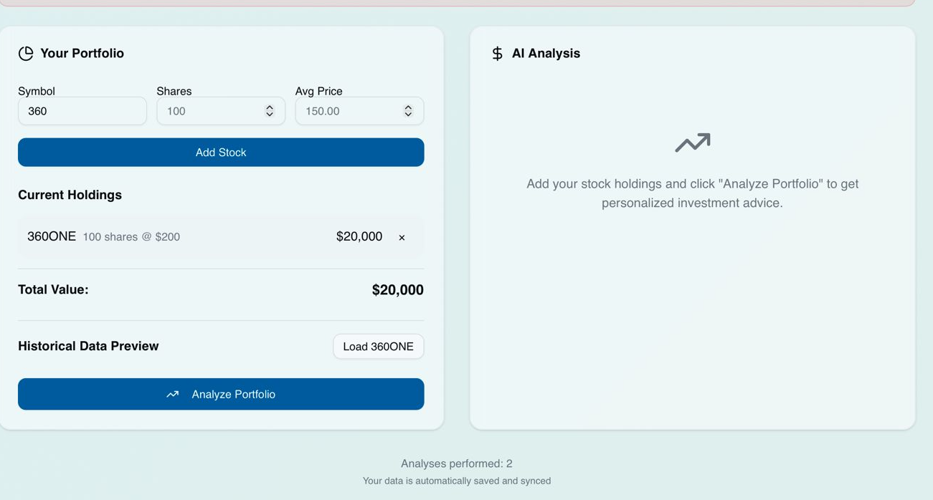
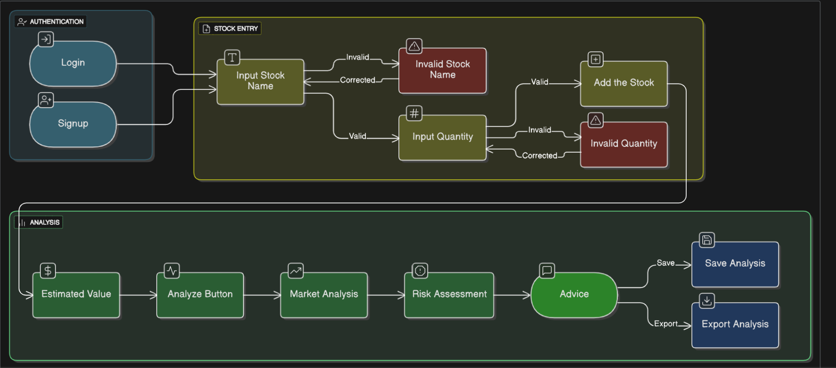
Flowchart & Supporting Images
Supporting Images
Flowchart

Slide 6
Feasibility and Market Use
Feasibility
Technical Feasibility:
The project is feasible using existing tools. Pathway can easily integrate mock or real-time stock data.
Basic portfolio input and analysis can be implemented with simple rules before moving to advanced AI models.
Usage tracking and billing can be managed through Flexprice, which supports per-use pricing models.
Operational Feasibility:
The system does not require deep financial expertise from the user; it explains advice in plain language.
Beginners can use it without needing to understand charts or complex ratios.
Economic Feasibility:
Since billing is based on usage, the cost is scalable and affordable for small investors.
Development cost is reasonable because it uses existing APIs, data sources, and billing platforms.
Market Use
Target Users:
Students, first-time investors, and small retail investors who lack financial expertise.
Value Proposition:
Unlike traditional apps that only show prices, this tool provides actionable advice (buy/sell/hold/diversify).
Users get personalized insights without depending on friends, random videos, or guesswork.
Transparent billing ensures users pay only for what they use.
Market Potential:
With growing retail participation in stock markets, there’s a huge demand for simplified advisory tools.
This tool can become an affordable alternative to expensive financial advisors.
It can also be integrated into existing fintech apps as a feature.

Slide 7
Conclusion
The Stock Consultant Agent bridges the gap between complex stock data and the simple, actionable advice that beginners and small investors need. By combining portfolio input, updated stock data through Pathway, and a clear advice engine, the system translates raw numbers into easy-to-understand guidance like buy, sell, hold, or diversify. With integrated usage tracking and Flexprice-based billing, it ensures transparency and scalability, making it both technically feasible and economically viable. This solution empowers users to make smarter investment decisions with confidence, without relying on guesswork or scattered sources of advice.

Slide 8
GITHUB REP:Stock wise

